Slide 1

Class #27

Slide 2
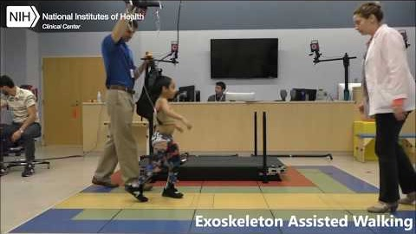

Slide 3
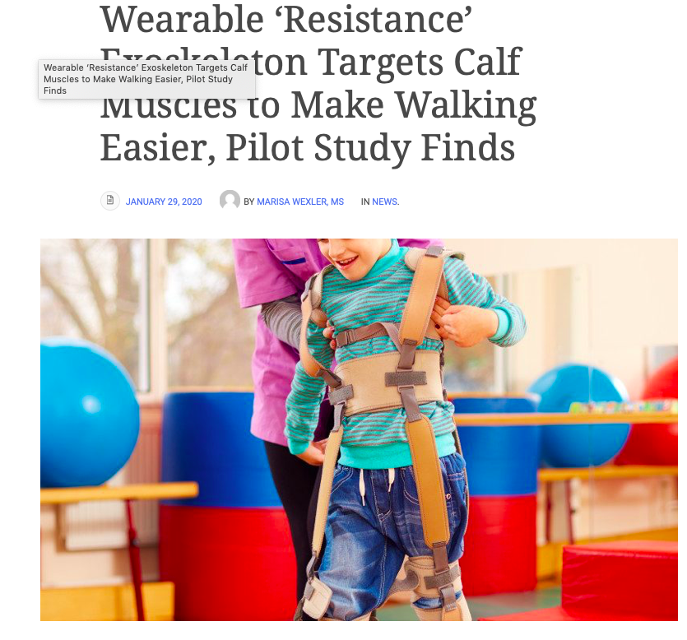
Notes:
https://cerebralpalsynewstoday.com/2020/01/29/robot-exoskeleton-worn-on-leg-strengthens-calf-muscles-eases-walking-in-cp-pilot-study/

Slide 4
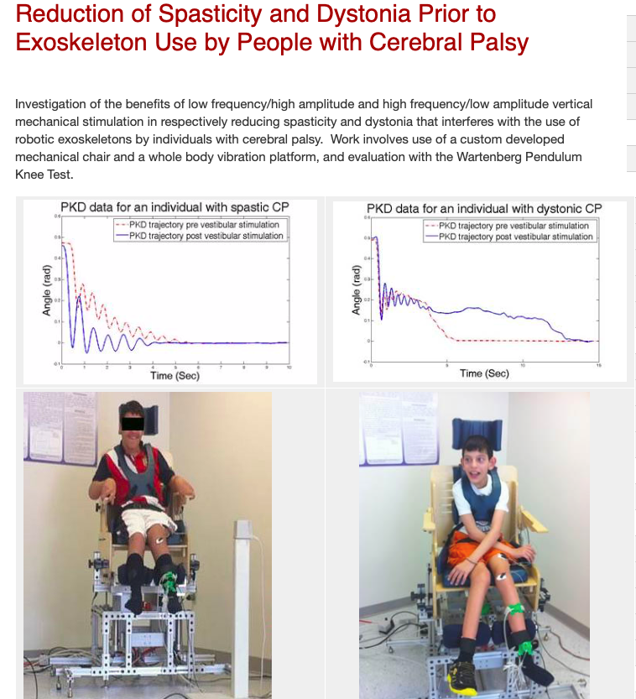
Notes:
https://centers.njit.edu/rehabilitation/reduction-spasticity-and-dystonia-prior-exoskeleton-use-people-cerebral-palsy/

Slide 5
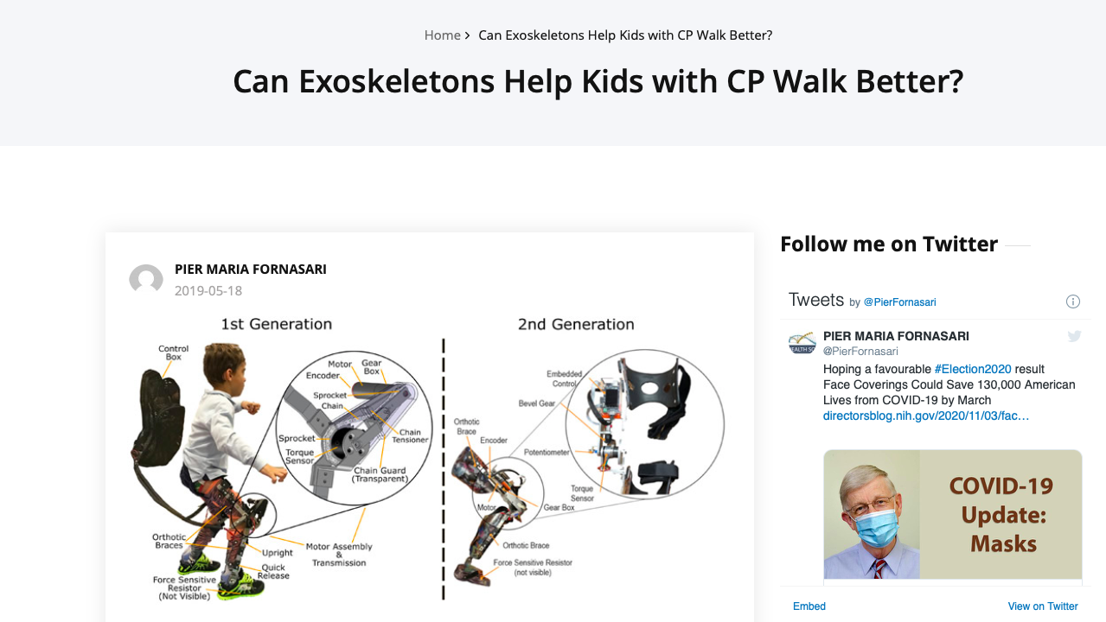
Notes:
https://www.regenhealthsolutions.info/2019/05/18/can-exoskeletons-help-kids-with-cp-walk-better/

Slide 6
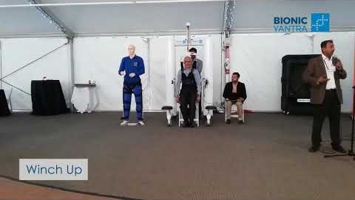

Slide 7

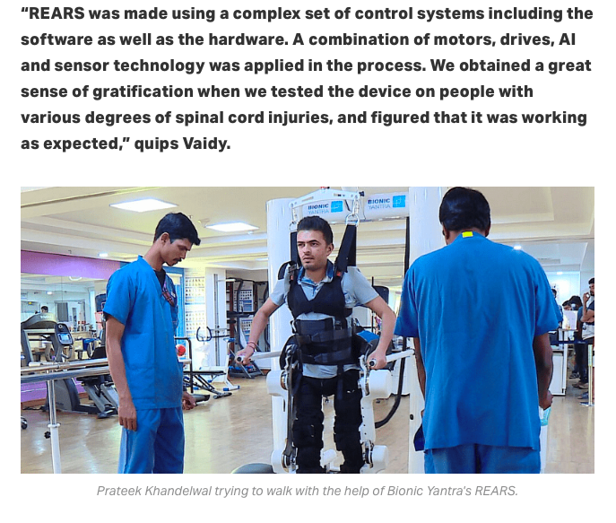
Robotic Exoskeleton Assisted Rehabilitation Systems (REARS).
Notes:
Read more at: https://yourstory.com/socialstory/2020/03/startup-robotic-device-spinal-injury-mobility

